Slide 1
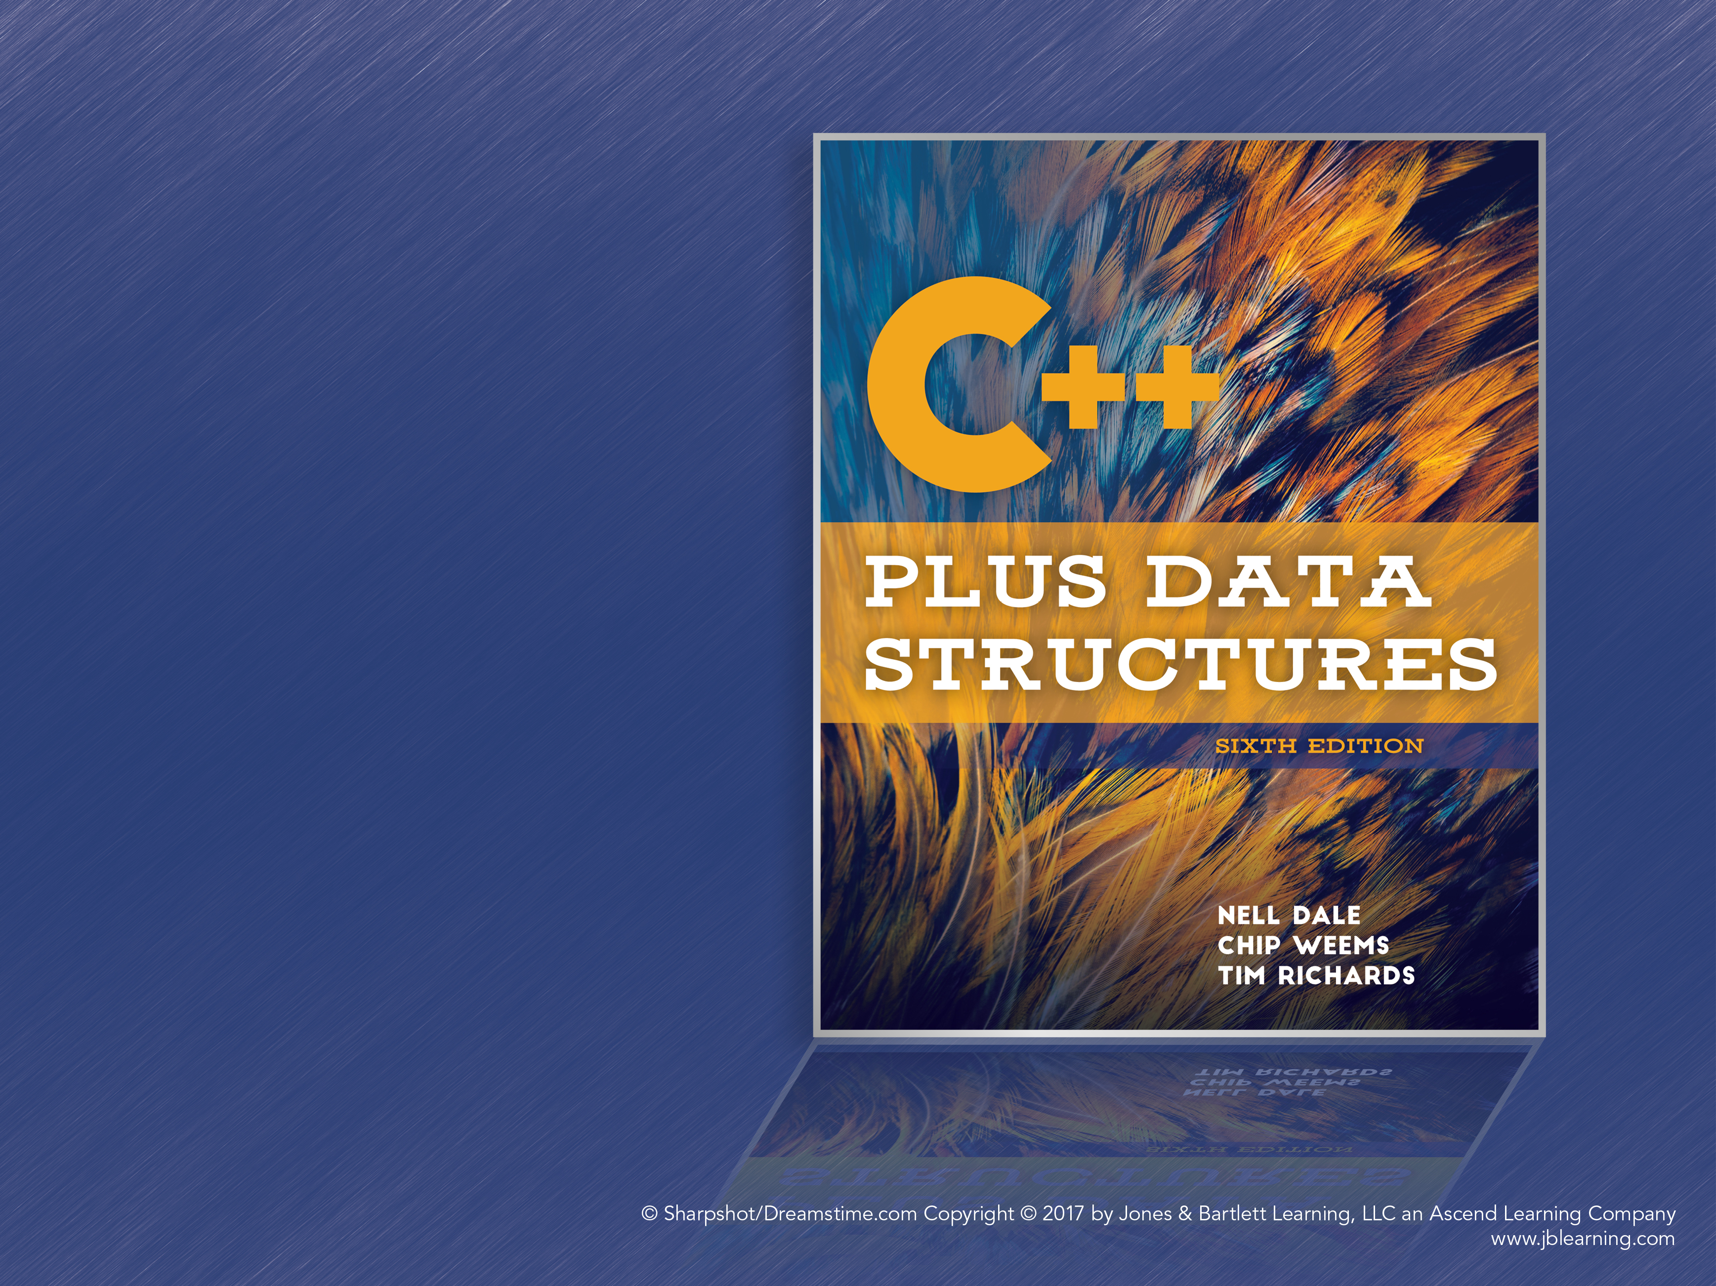
Chapter 11
Sets, Maps, and Hashing

Slide 2
Sets: Logical Level
Set: An unordered collection of distinct values, based on the mathematical concept
Component (base) Type: The data type of the items in a set
Subset: A set whose items are contained entirely within another set
Universal Set: The set containing all the possible values of the base type
Empty Set: A set with no members

Slide 3
Set Operations
Store and Delete for adding and removing items from the set
Union: Combine two sets into one
Intersection: Takes two sets and creates a third containing the values that are in both sets
Difference: Returns the set of all elements that are in the first set but not the second
Cardinality: The number of items in a set

Slide 4
Set Operation Examples
SetA = {A, B, D, G, Q, S}
SetB = {A, D, P, S, Z}
Union (SetA, SetB) = {A, B, D, G, P, Q, S, Z}
Intersection (SetA, SetB) = {A, D, S}
Difference (SetA, SetB) = {B, G, Q}
Difference (SetB, SetA) = {P, Z}

Slide 5
Additional Operations
Observers: IsEmpty and IsFull
Transformer: MakeEmpty
Utility: Print
Note that Store and Delete are equivalent to Union and Intersection with the set containing only the target element

Slide 6
Sets: Application Level
One unique property of sets is that storing an item that is already in the set does not change the set
Similarly, deleting an item that’s not in the set does not affect anything
This can useful for building a list of the words in a text, for example

Slide 7
Sets: Implementation Level
There are two general ways to implement sets
Explicit representation: The presence and absence of every possible value in the base type is recorded
Implicit representation: Only the items in the set are recorded

Slide 8
Explicit Representation
The explicit representation maps each item in the base type to a Boolean flag
If the item is in the set, the flag is set to true
Bit Vector: An array of bits, typically used as a compact list of Boolean flags
It must be possible to enumerate every possible value of the base type
Works best for base types with small domains

Slide 9
Explicit Representation (cont.)
Store finds the bit for the given item and sets it to 1; Delete sets the appropriate bit to 0
Union, Intersection, and Difference loop through the bit vector and use bitwise operations:
Union: OR the two bit vectors
Intersection: AND the two bit vectors
Difference: AND with the NOT (inversion) of the second bit vector

Slide 10
Implicit Representation
Store only the items that are in the set
The set itself is stored as a list
Store uses RetrieveItem to see if the item is already in the set, and inserts it if not
Delete uses RetrieveItem and only tries to delete the item if it’s actually in the set

Slide 11
Implicit Set Intersection
Naive algorithm: For every item in Set A, check if it’s in Set B. If yes, store it in the result set.
This is O(N*N) or O(N log₂N), depending on the implementation of RetrieveItem.
Can we do better? Yes, by changing the assumptions about ItemType to get an algorithm with O(N) performance.

Slide 12
Implicit Set Intersection (cont.)
If ItemType supports “<” a sorted list can be used to store the sets
Sets are still unsorted collections, but the implementation can be sorted
Compare the first items in Sets A and B; if they’re equal, store one of them in the result
If A < B, get the next item in A
If B < A, get the next item in B

Slide 13
Intersection Pseudocode
SetType Intersection(SetType setB):
Reset self
Reset setB
while NOT (self.IsEmpty OR setB.IsEmpty)
GetNextItem(itemA) from self
setB.GetNextItem(itemB)
if (itemA < itemB)
GetNextIem(itemA) from self
else if itemB < itemA
setB.GetNextItem(itemB)
else
result.Store(itemA)
GetNextItem(itemA) from self
setB.GetNextItem(itemB)
return result

Slide 14
Explicit or Implicit?
Explicit representation must be able to represent every item in the base type
That is, the length of the bit vector is the cardinality of the universal set
Implicit representation requires searching the list to find if an item is already in the set
Explicit is better for base types with a very small number of unique values

Slide 15
Maps: Logical Level
An ADT that is a collection of key-value pairs
Key: A value of the base type of the map, used to look up an associated value
Like sets, maps store unsorted, unique values
They do not support Union, Intersection, and Difference and have no mathematical basis
Supports Find, an operation for retrieving a key-value pair by searching for the key

Slide 16
Maps: Application Level
Arrays can be seen as maps that use integers as keys
Maps, then, are like arrays whose keys cannot easily be converted into array indices
Example: mapping names to phone numbers

Slide 17
Maps: Implementation Level
The most common map operation is Find
Binary Search Trees support very efficient searching, along with insertion and deletion
Insertion: If the key is already in the map, the map is not changed
Find is basically identical to GetItem, except it only checks for the correct key
ItemType contains the key and the value

Slide 18
Maps: Other Approaches
Find could return void and use an empty value or a bool flag to indicate failure
It is very useful for clients that search does not “fail” (throw an exception) and instead returns a dummy value or a flag that can be checked
The C++ STL overloads [ ] so that maps can be treated like arrays

Slide 19
O(1) Search
Is it possible to have O(1) search?
There would have to be a 1-to-1 mapping between element keys and array indices
For example: Employees with IDs ranging from 00 to 99, stored in an array by ID
But if IDs were from 00000 to 99999 and there were only a few hundred employees, tons of memory would be wasted

Slide 20
Hashing
Hashing: A technique for ordering and accessing elements in a list by manipulating the key of the element
Hash Function: A function that manipulates the key to produce an array index
For example, the 5-digit employee IDs could be hashed using Key % 100 to produce a 2-digit array index

Slide 21
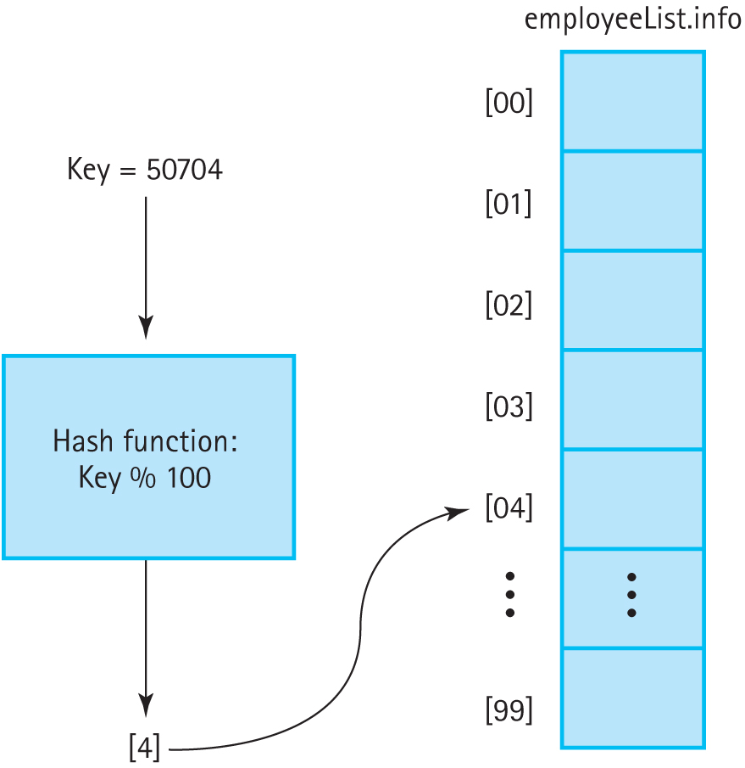
Hashing (cont.)
Figure 11.1 Using a hash function to determine the location of the element in an array

Slide 22
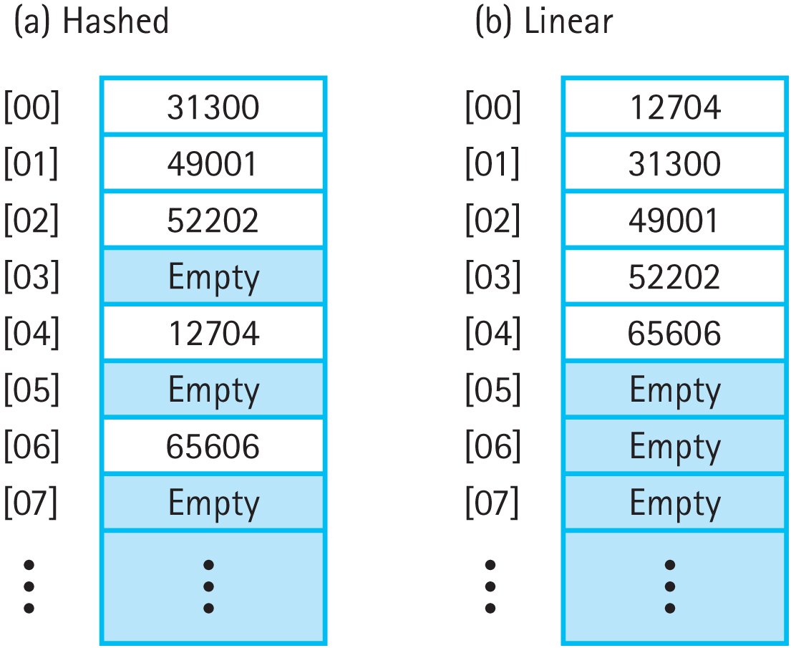
Hashing vs. Sequential Lists
Figure 11.2 Comparing hashed and sequential lists of identical elements (a) Hashed
(b) Linear

Slide 23
Collisions
What happens if we hash 01234 and 97534?
Both produce the hash value “34”
Collision: When multiple keys produce the same hash location
A good hash function minimizes collisions, but they’re impossible to completely avoid
How can collisions be resolved?

Slide 24
Linear Probing
Resolves hash collisions by searching for the next available space
If the end of the hash is reached, linear probing loops around to the beginning
To check if an item is in the hash table, calculate the hash and search sequentially until the matching key is found; stop when an empty space or the original hash is found

Slide 25
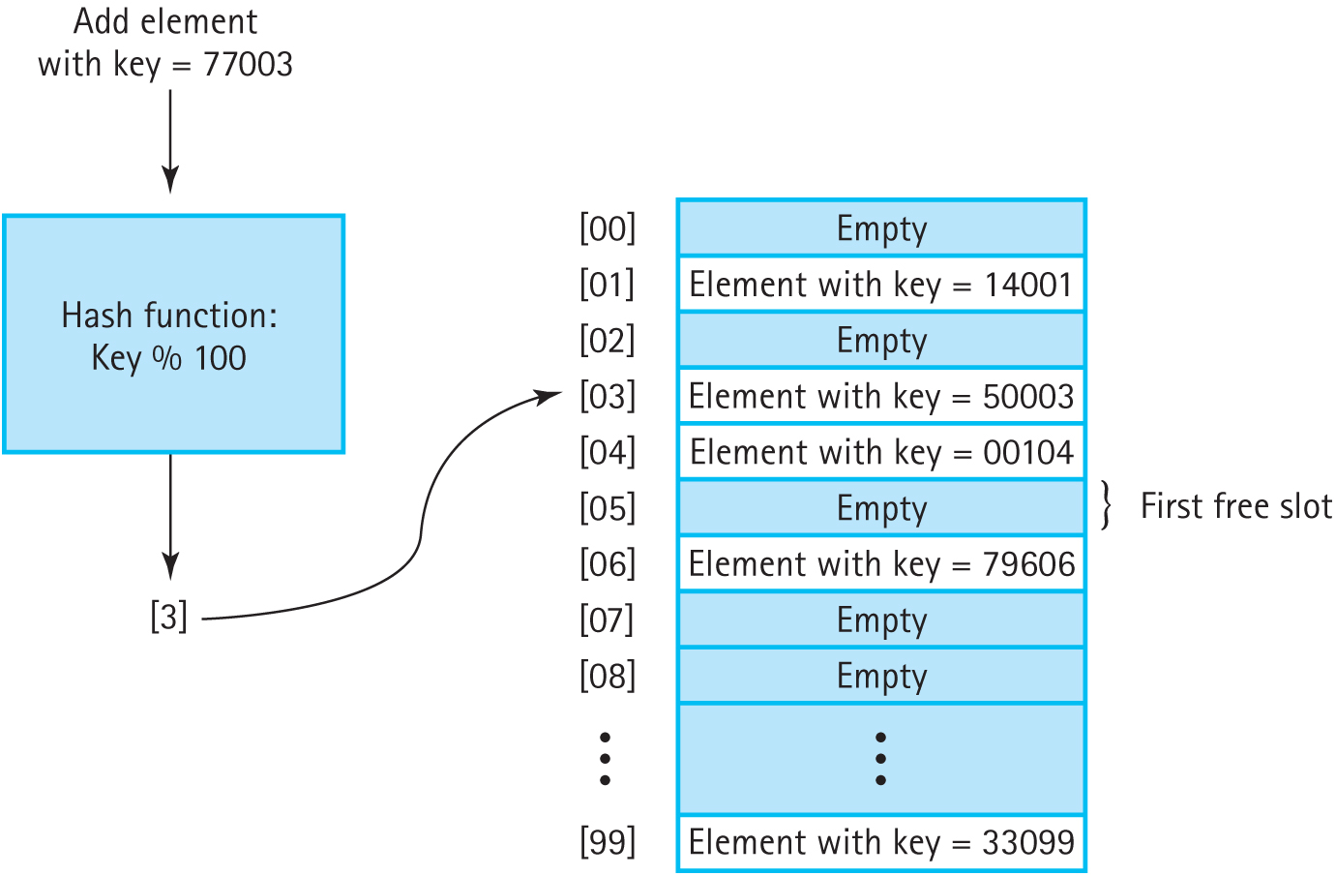
Linear Probing (cont.)
Figure 11.3 Handling collisions with linear probing

Slide 26
Linear Probing and Deletion
Deleting an item creates an empty spot
What happens if three items with the same hash are inserted, the second one is deleted, and then the client searches for the third?
Linear probing will stop when it encounters the deleted second item’s slot, reporting that the third item does not exist
A dummy “deleted item” value tells search to keep looking

Slide 27
Clustering
The tendency of elements to become unevenly distributed throughout a hash table
A good hash function will have a uniform distribution of hash keys
But linear probing will cause clustering anyway
This makes insertion and retrieval less efficient

Slide 28
Rehashing
Using the hash value as the input to a hash function in order to find a new location
A good rehashing function for linear probing:
(hash value + c) % s
Where c and s are two integers whose greatest common divisor is 1, e.g., c = 3 and s = 100
The two constants must be relatively prime so that rehashing covers the whole array

Slide 29
Quadratic and Random Probing
Quadratic probing rehashes based on the number of times the rehashing function has been called (I)
(HashValue ± I²) % array size
Reduces clustering, but doesn’t use every index
Random Probing: Generate random rehash values; eliminates clustering, but slow

Slide 30
Buckets and Chaining
Handle collisions by allowing multiple elements to have the same hash value
Bucket: A collection of values associated with the same hash key; has limited space
Chain: A linked list of elements that share the same hash key; the hash table has pointers to list of values

Slide 31
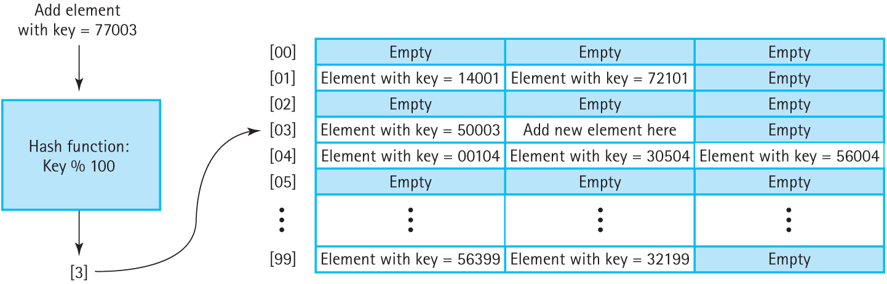
Buckets
Figure 11.6 Handling collisions by hashing with buckets

Slide 32
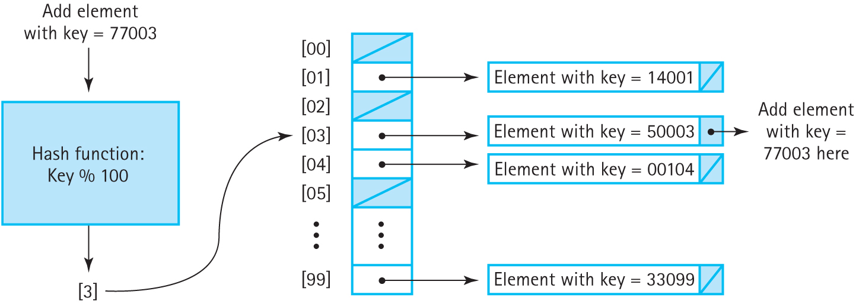
Chaining
Figure 11.7 Handling collisions by hashing with chaining

Slide 33
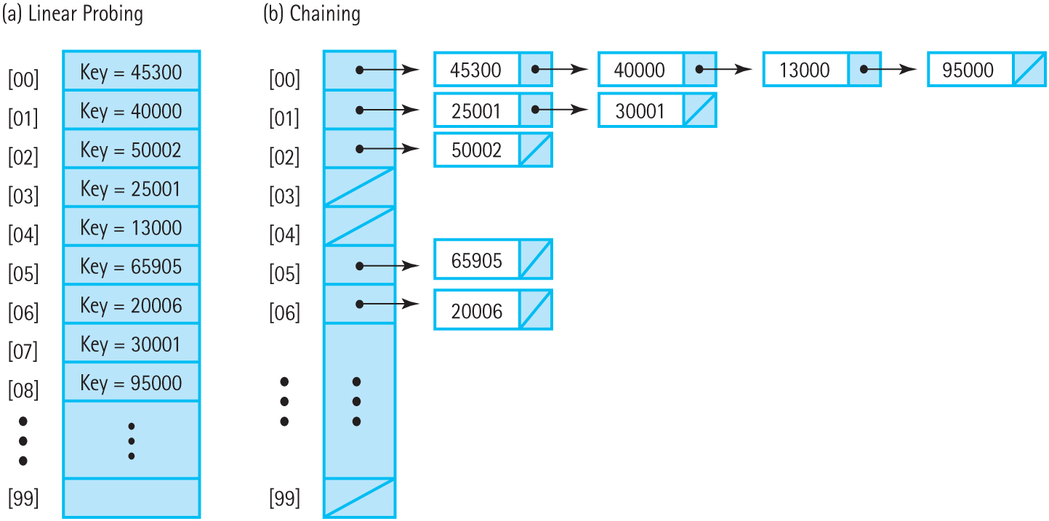
Probing vs. Chaining
Figure 11.8 Comparison of linear probing and chaining schemes (a) Linear Probing
(b) Chaining

Slide 34
Probing vs. Chaining (cont.)
Search: Probing must continue searching the array until all possible hash keys have been checked. Chaining only looks through the chain, which is likely to be relatively small.
Deletion: Chaining simply removes the element from the linked list. Probing requires special signal values.

Slide 35
Choosing a Good Hash Function
A good hash function reduces collisions by uniformly distributing elements
Knowledge about the domain of keys helps
For example, Key % 100 is terrible for employee IDs if the last two digits are the year the employee was hired
Probing, buckets, and chaining can only do so much when there’s many collisions

Slide 36
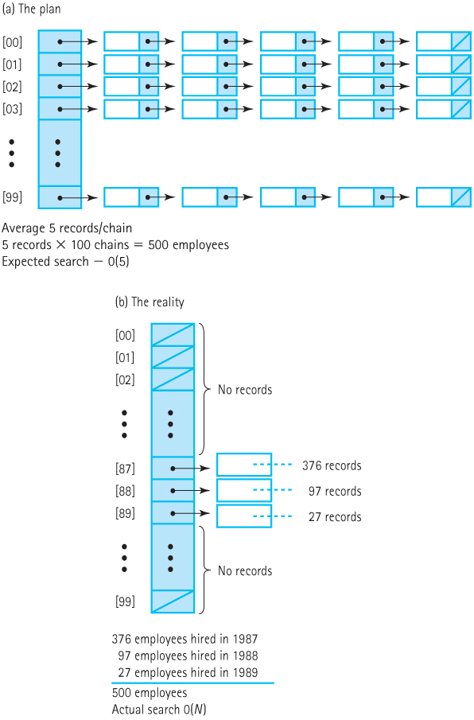
Hashing Employee IDs
Figure 11.9 Hash scheme to handle employee records (a) The plan (b) The reality

Slide 37
Division Method
The most common hash method: key % size
By making the table larger than the expected number of elements, collisions can be reduced
Very efficient, but collisions can be common

Slide 38
Other Hash Methods
The division method requires integers
A string of characters could be hashed by summing up the individual letters first
Folding: Break the key into multiple pieces and concatenate or XOR the pieces to make a complete hash key

Slide 39
Creating a Good Hash Function
Efficiency: Hash tables have O(1) search. This deteriorates if the hash function is inefficient
Simplicity: Don’t forget hash functions need to be written and maintained! Complex functions may incur a technical cost.
Perfect hash functions are difficult but not impossible, especially for small sets of values.

